Slide 1

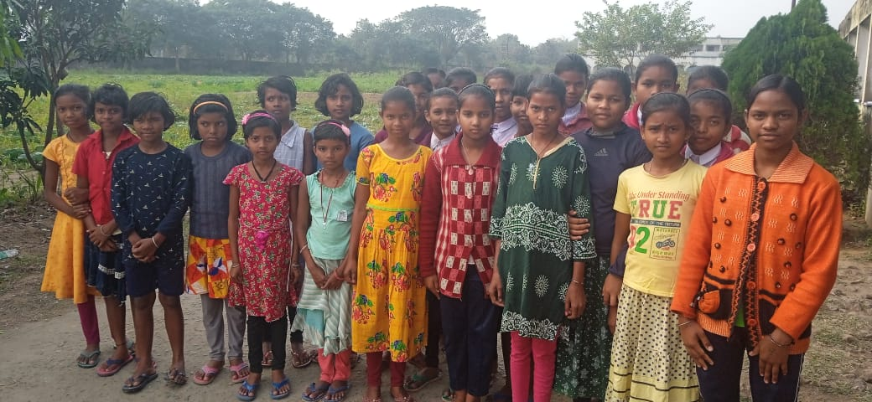
4th Annual Virtual Meet 16th February, 2025
LIVE 4 HELP FOUNDATION
Better Living by Helping

Slide 2
LIVE 4 HELP FOUNDATION
Better Living by Helping

Slide 3
“We ourselves feel that what we are doing is just a drop in the ocean. But the ocean will be less because of that missing drop.” - Mother Teresa
Our Mission, Vision & values
MISSION
VISION
VALUES
Our Mission is to identify the people who are seeking help for different needs and those who are willing extending their help, the bridge.
Live 4 Help Foundation believe in selfless service with honesty, integrity, accountability and transparency.
Our Vision is to provide help, bring smiles and joy of happiness to underprivileged and needy people
www.live4help.org
NEXT: 2023 highlights: Dr. Ramkrishna Sadhukhan: 3 mins
3

Slide 4
Our Members

Slide 5
agenda
Introduction Bibekananda Maiti
Educational support Subhabrata Chakrabarti
Environmental, Medical and relief support Bibekananda Maiti
Financials Tarun Maiti
We solicit your support Debasish Das Ramkrishna Sadhukhan Shubhendu Shekhar Mal

Slide 6
Educational support Subhabrata Chakrabarti

Slide 7
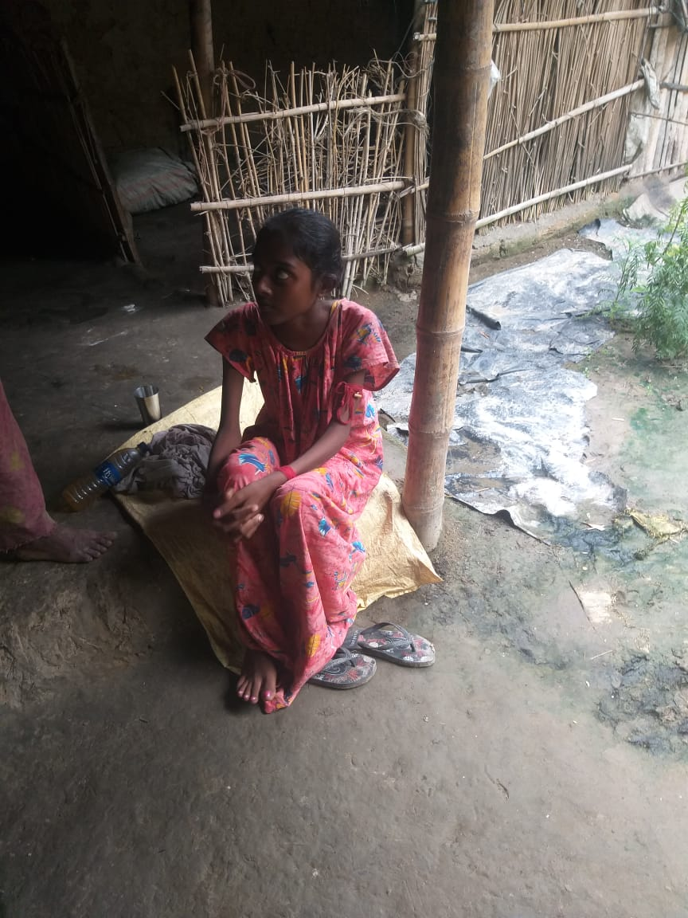
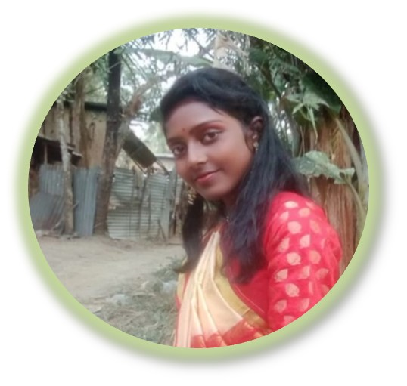
Subhankari's Journey: From Vulnerability to Vibrancy Once a frail and ailing child, Subhankari's life was transformed through nourishment and care. With access to wholesome food, medical attention, and educational support, she blossomed into a strong and capable individual. Her bright smile and infectious laughter echo the resilience of the human spirit. Subhankari's story inspires us to nurture and empower the most vulnerable among us, unlocking a brighter future for generations to come.
A face behind our inspiration for educational support

Slide 8
Current Beneficiaries
Sl. No. | Student Name | Gender | Class | State | Enrollment with L4H | Current Support
1 | Aditi Joshi | Female | VIII | Uttarakhand | Sep'21 | School Fees
2 | Anirban Kabiraj | Male | XII (Science) | West Bengal | Sep'21 | Books, Stationery, Coaching
3 | Anjali Kisku | Female | Computer course | West Bengal | May'22 | Course Fees, Transport
4 | Bibhuprasad Panda | Male | V | Orissa | Jun'21 | School Fees
5 | Devyani Joshi | Female | XII (Science) | West Bengal | Sep'21 | School Fees
6 | Gourinath Mahato | Male | XII (Science) | Uttarakhand | Dec'21 | Tuition Fees, Stationery
7 | Hriday Pramanik | Male | XII (Science) | West Bengal | Sep'21 | Tuition Fees, Books ,Stationery
8 | Mamoni Kalindi | Female | B. A. 3rd Year (Bengali) | West Bengal | Aug'21 | Books, Stationery, Semester Fee
9 | Priyanka | Female | B.A (Pol Sc.), 2nd Year | Delhi | Dec'21 | Admission Fee
10 | Purnima Das | Female | X | West Bengal | Aug'21 | Tuition Fees
11 | Rohan Ghosh | Male | XII (Science) | West Bengal | May'22 | Tuition Fees
12 | Salma Khatun | Female | X | West Bengal | Dec'21 | Tuition Fees
13 | Shweta Singh | Female | IX | Delhi | Aug'21 | School Fees including Books
14 | Sonali Hembram | Female | XII (Science) | West Bengal | May'22 | Tuition Fees, Books, Stationery
15 | Soumyadip Bhattacharyya | Male | XII (Science) | West Bengal | Aug'21 | Tuition Fees
16 | Subham Pandey | Male | B. Sc. 2nd Year (Physics) | West Bengal | Aug'21 | Tuiton Fee, Books, Semester Fee
17 | Sukumar Das | Male | B. A. 3rd Year (Sanskrit) | West Bengal | Oct'21 | Admission Fee
18 | Suvankari Mondal | Female | B. A. 3rd Year (Arts) | West Bengal | Aug'21 | Tuition Fees, Health, Livelihood
19 | Trayee Sarkar | Female | B. A. 2nd Year (Arts) | West Bengal | Aug'21 | Tuition Fees
Sl. No. | Student Name | Gender | Class | State | Enrollment with L4H | Current Support
20 | Sachetan Jha | Male | VII | Bihar | Sep'22 | School Fees
21 | Saharsh Jha | Male | II | Bihar | Sep'22 | School Fees
22 | Sayani Mukherjee | Female | XI (Science) | West Bengal | Sep'22 | Tuition Fees
23 | Ajanta Roy | Female | B.MLT | West Bengal | Sep'22 | Course Fees
24 | Elora Roy | Female | B.MLT | West Bengal | Sep'22 | Course Fees
25 | Mohini Kumari | Female | X | Uttar Pradesh | Oct'22 | Tuition Fees, Coaching
26 | Sadhna Kumari | Female | IX | Uttar Pradesh | Oct'22 | Tuition Fees
27 | Subham Bhattacharyya | Male | XII (Science) | West Bengal | Oct'22 | Tuition Fees, Coaching
28 | Dipranjan Mandal | Male | XI | West Bengal | Apr'23 | Tuition Fees
29 | Srijita Basak | Female | B. A. 1st Year | West Bengal | Jun'23 | Tuition Fees
30 | Mahin Parween | Female | IX | Jharkhand | Oct'23 | School Fees
31 | Punam Kisku | Female | VIII | Jharkhand | Nov'23 | School Fees
32 | Mukhi Moni | Female | XI | West Bengal | Oct'23 | Tuition Fees
33 | Sila Soren | Female | III | West Bengal | Oct'23 | Tuition Fees
34 | Rilamala Soren | Female | V | West Bengal | Oct'23 | Tuition Fees
35 | Rupali Hembram | Female | VI | West Bengal | Oct'23 | Tuition Fees, Health, Livelihood
36 | Chandmoni Hembram | Female | B. A. 1st Year | West Bengal | Aug'24 | Tuition Fees
37 | Chaitali Kisku | Female | IX | West Bengal | Aug'24 | Tuition Fees
38 | Jayprakash Panda | Male | II | Orissa | Apr'24 | School Fees
39 | Subhani Parween | Female | VIII | Jharkhand | Apr'24 | School Fees
40 | Shatarupa Mandal | Female | M.B.B.S | West Bengal | Dec’24 | School Fees

Slide 9
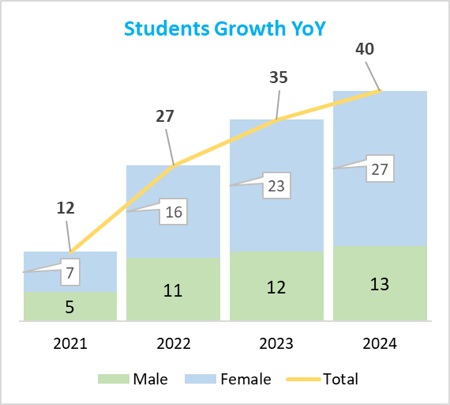
Highlights
Five new students added during the year
Seven States - Delhi, WB, UP, Orissa, Uttarakhand, Jharkhand, Bihar
67% students are girls
One student studying B.Sc. (Geography)
One student pursuing B.Ed, after completing M. A in Sanskrit
One student studying in ECE (Electronics and Comm. Engineering)
One student studying in B.Sc.(Botany Honours)
One Student in his final year of M.Sc. (Physics) @ IIT, Madras
One Student in her 1st year of Medical, Bankura Medical College, W.B.
2025 goal is to secure at least 10 new sponsors and expand cumulative student base to 50.

Slide 10
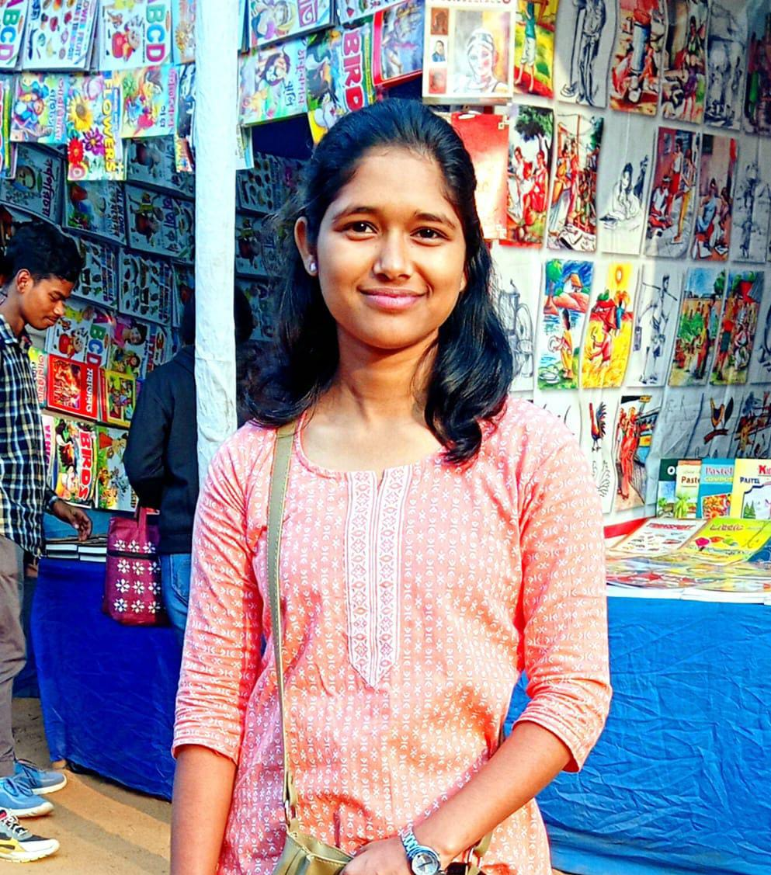
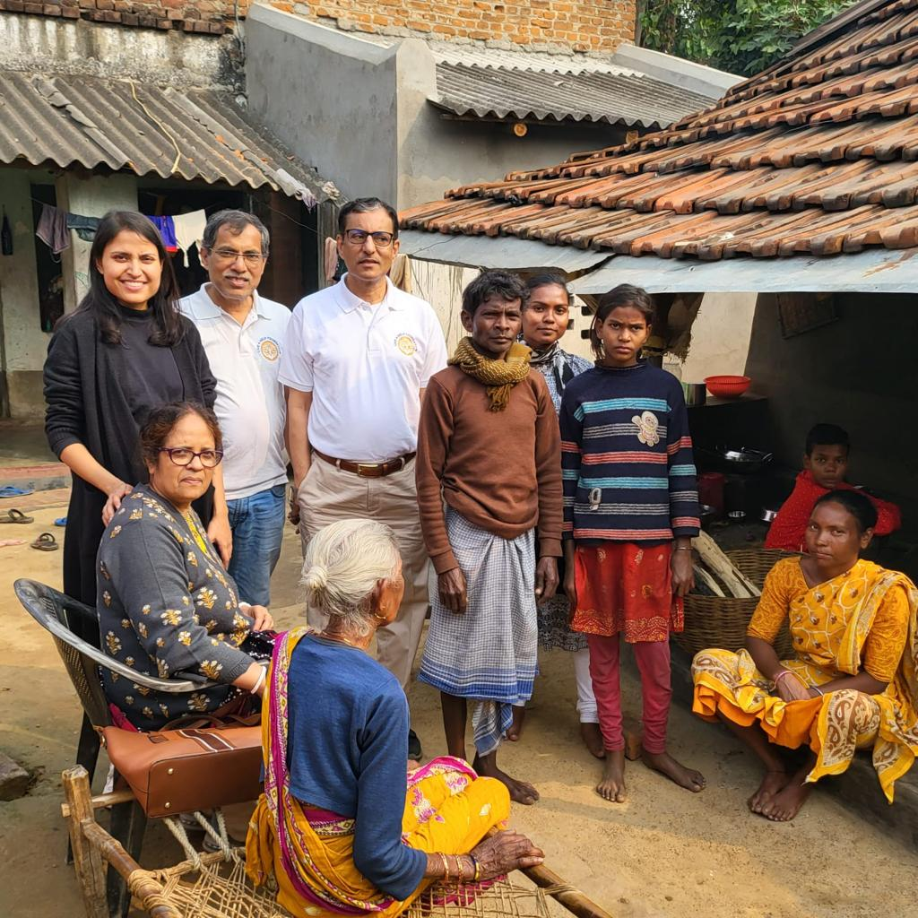
Rupali, Tribal girl, Bankura, West Bengal, lost both parents, stay with Grand Mother, having no farming land, struggling for livelihood and survival
Rupali Hembram
Shatarupa Mandal
Shatarupa, Village girl from Sundarban area, father migrant labour, determined to pursue medical.

Slide 11
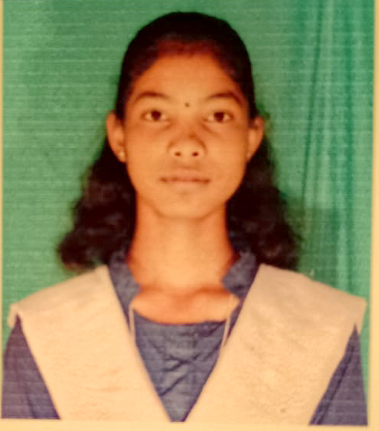
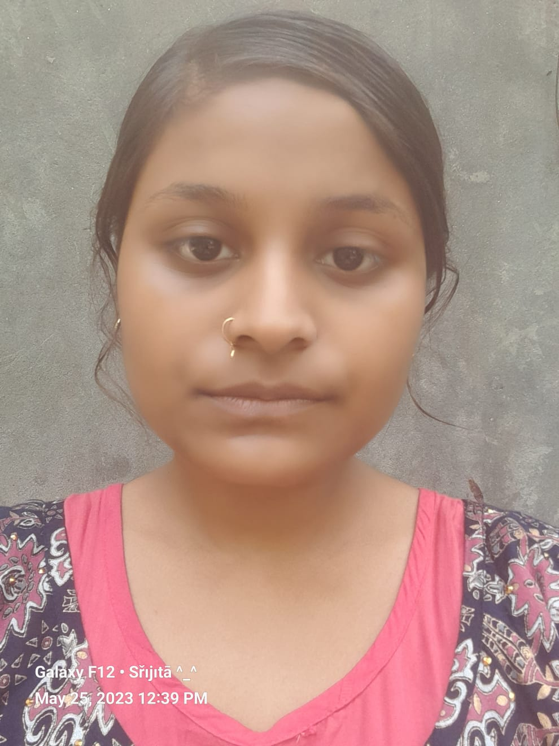
Srijita Basak Secured 4th position in West Bengal H.S Exam. Her father a toto driver, She is studying B.A (Geography honours) and has ambition for higher studies
Chaitali Kisku
Chaitali, daughter of a daily labour, is a good painter, She always secures high marks in all painting competitions. Wish to pursue a career in fine arts.

Slide 12
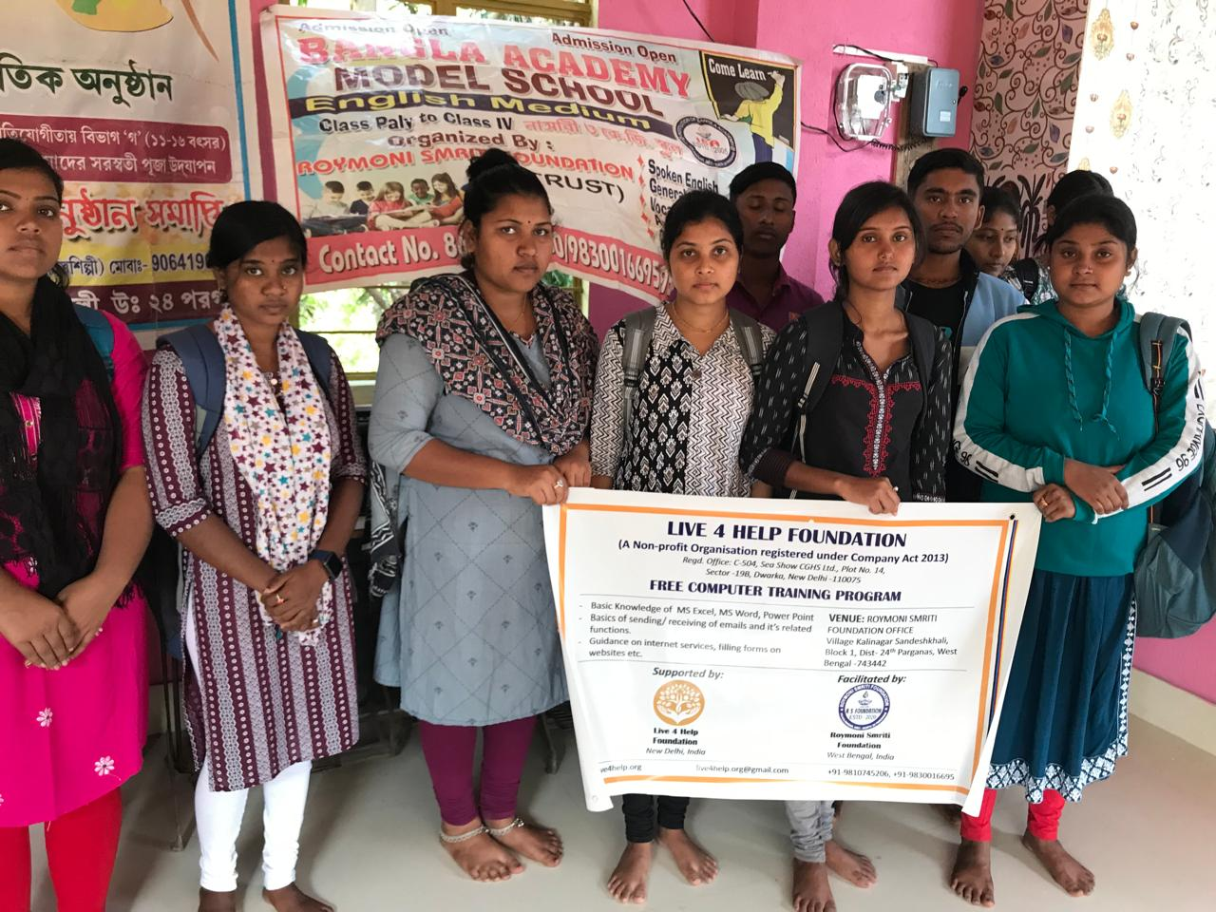
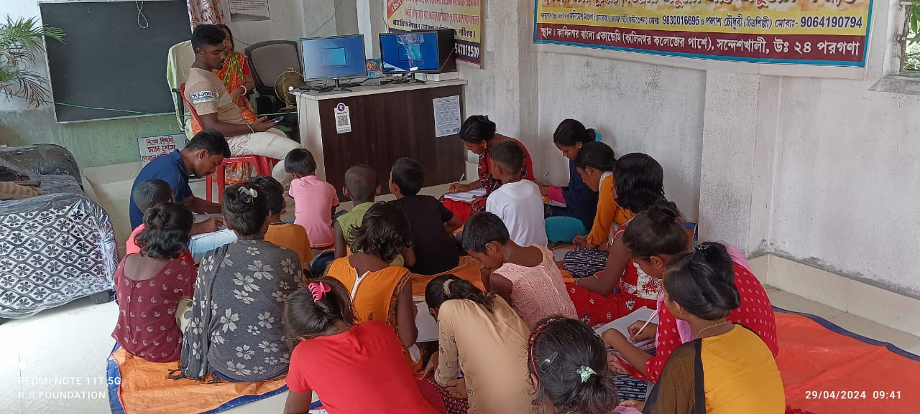
Started free computer training program, in collaboration with Roymoni Smriti Foundation Sponsor: Debashis Das Appeal for more computers
Sandeshkhali

Slide 13
Selection process
Once we receive leads from our members & field partners, we review cases in a core group meeting and decide upon. If leads come up with identified sponsors it helps decision making.
Selection Criteria
Meritorious student
Family income around 10000/-
Single parent / no parent
Preference class VII & higher
Search
Continuous scouting for eligible candidates with the help of our Partners.
Identification of students
Sample sponsorship amount
Average Rs. 36,000 annually for tuition fees
Books and stationaries as required
Preference of sponsorship
To contribute one-time for one year requirements
To continue for at least 2/3 years
Providing all necessary information on a flyer about the prospect and their needs to all our members and acquaintances requesting for sponsorships
Appeal
And
Expenses
Providing career counseling for them to further excel in the future
Interaction
And
Counceling
Periodic interaction with students to follow up on their progresses and make our sponsors updated on the same.

Slide 14
Medical Camps Mangroves Plantation Disaster Relief Camps Bibekananda Maiti

Slide 15
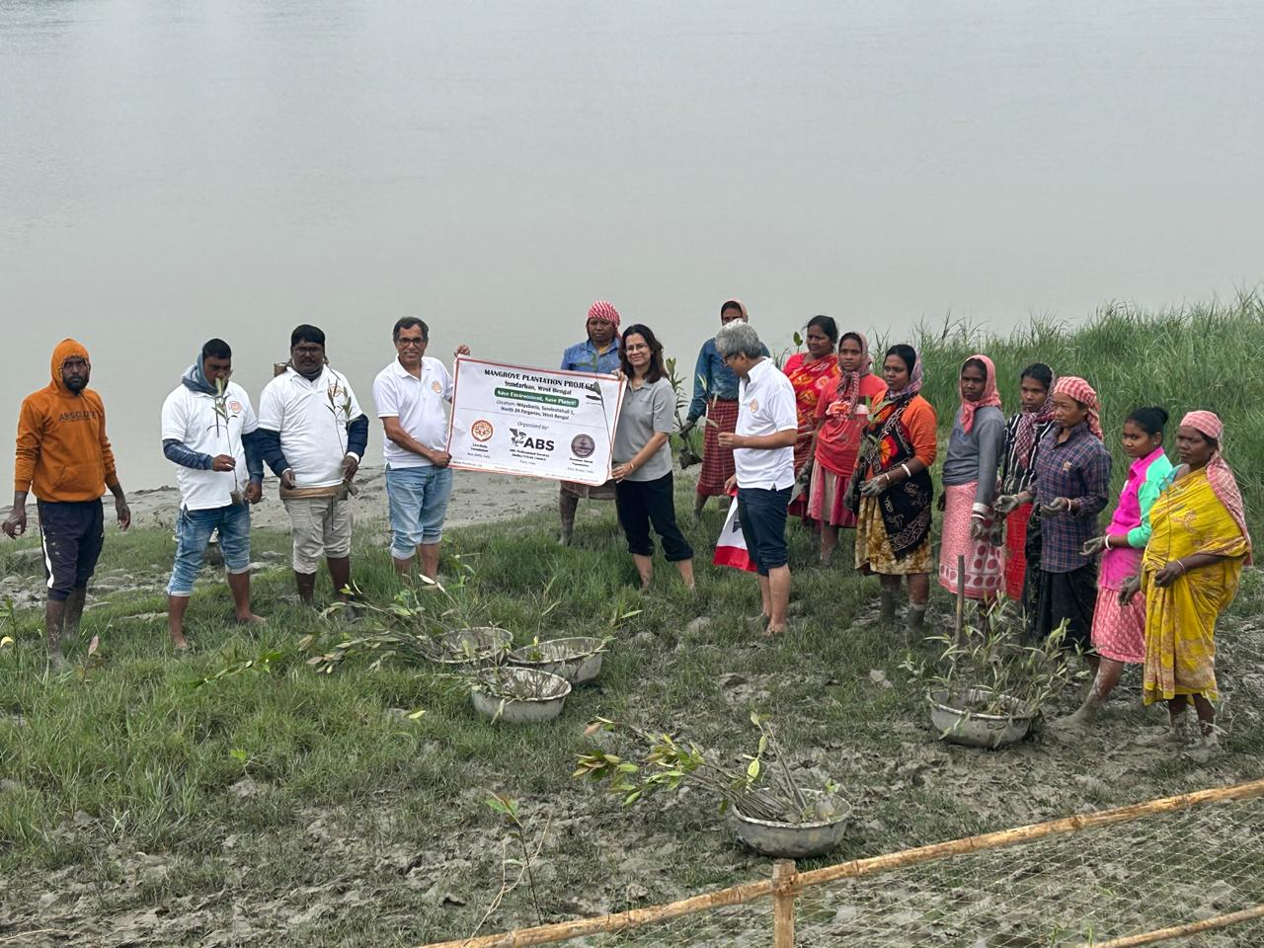
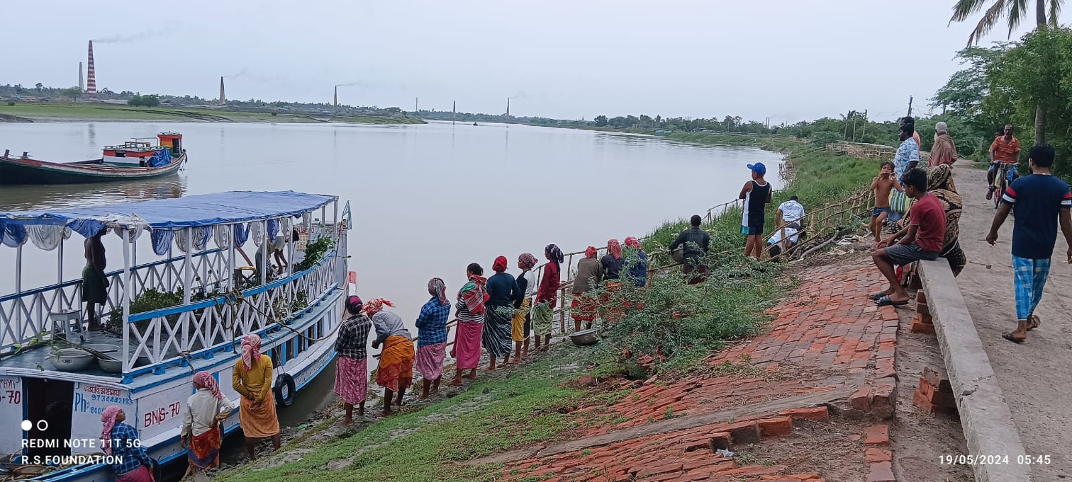
Let us hear from: Mr. Anindya Talukdar, (Managing Director) ABS Professional Services(India) Private Limited Team ABS Mrs. Suchitra Basu Mr. Soumalaya Mondal Mr. Sanjay Bandyopadhyaya
Mangrove Plantation Sandeshkhali, Sundarban

Slide 16
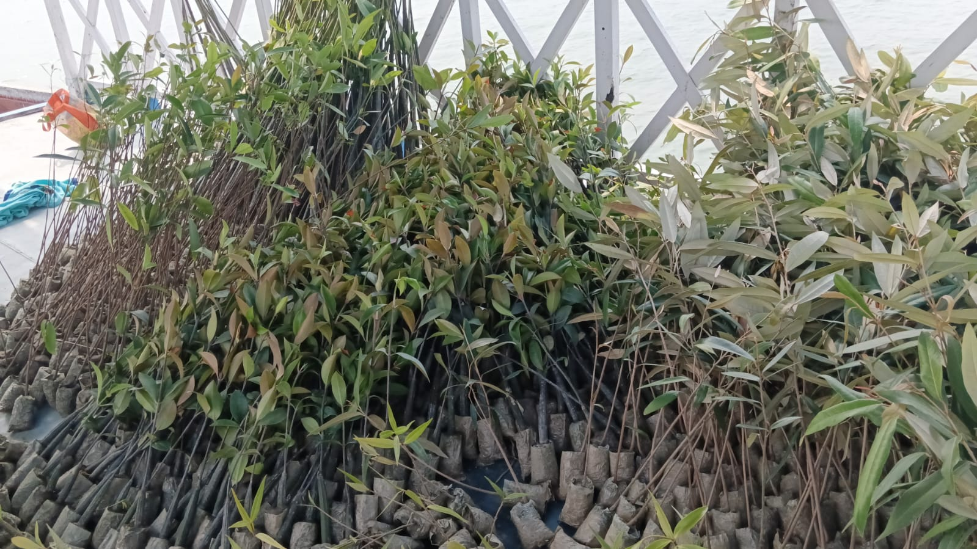
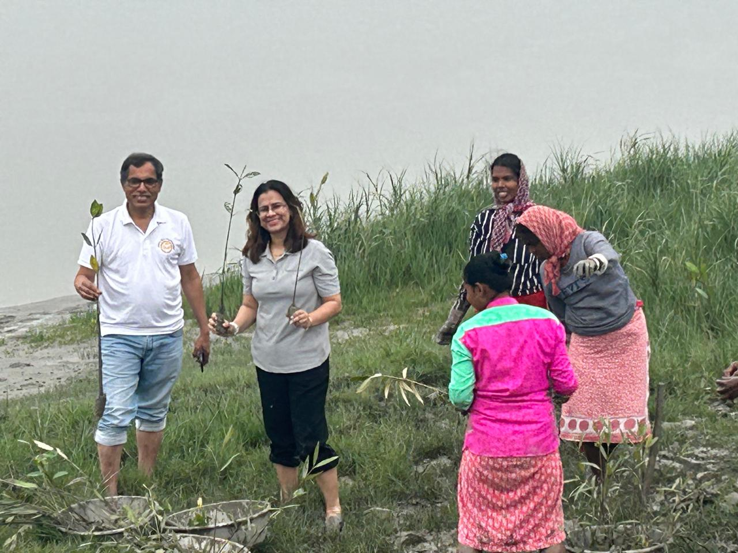
Let us hear from: Mr. Animesh Mandal, Founder Roymoni Smriti Foundation Team RMS Foundation: Mr. Ashim Kumar Das, Mr. Debkumar Sarkar, Mr Sayan Bar, Mr. Himanshu Mandal, Mr. Mihir Mistry, Mr Dipankar Mandal, Mr. Koushik Mandal, Mr Sakil Karikar, Mr. Raniit Sardar, Mr. Madhab Sardar
Mangroves Plantation Sandeshkhali

Slide 17
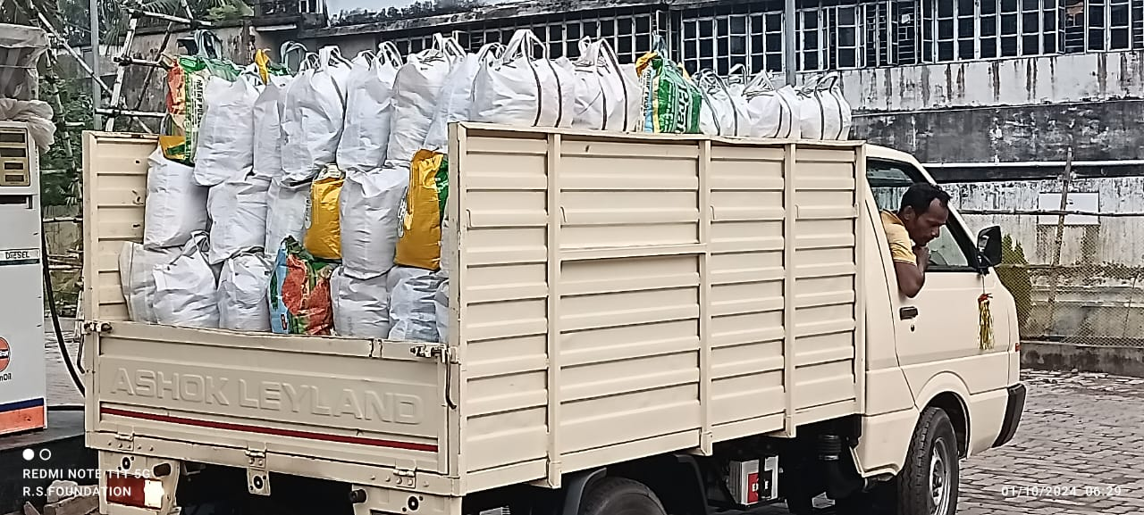
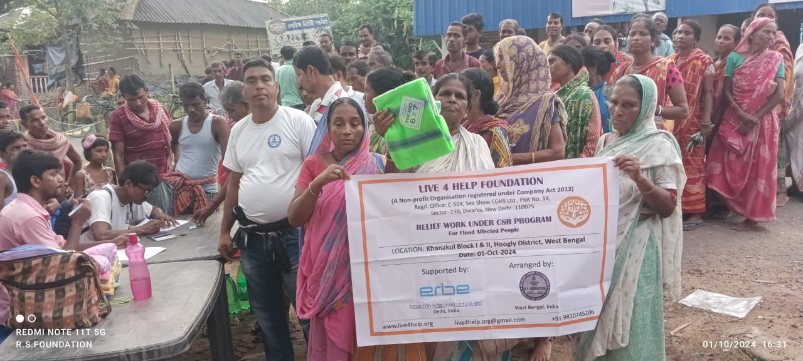
Distribution of Tarpaulin, Mosquito Nets and Rations Locations: 1. Sandeshkhal & Hingalgang, North 24 Parganas 2. Khanakul, Hoogly Beneficiary families: 400
Disaster Relief Initiatives
Sponsor: Erbe Medical India Pvt Ltd

Slide 18
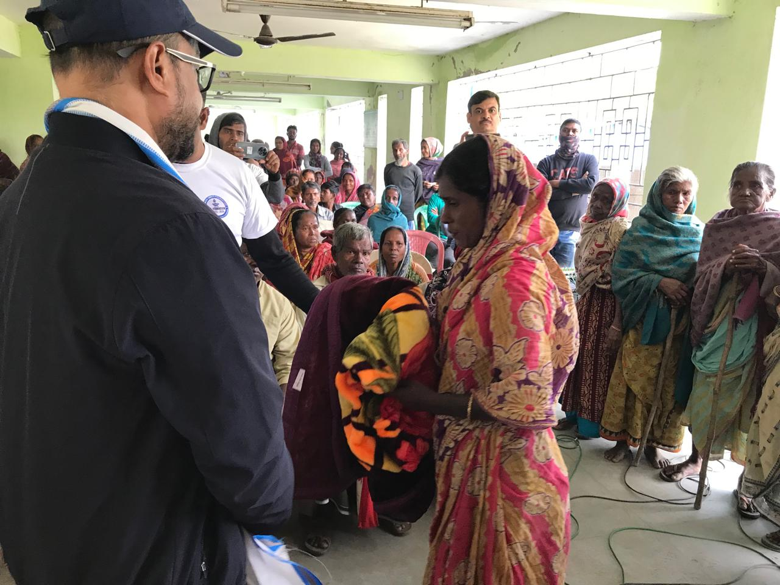
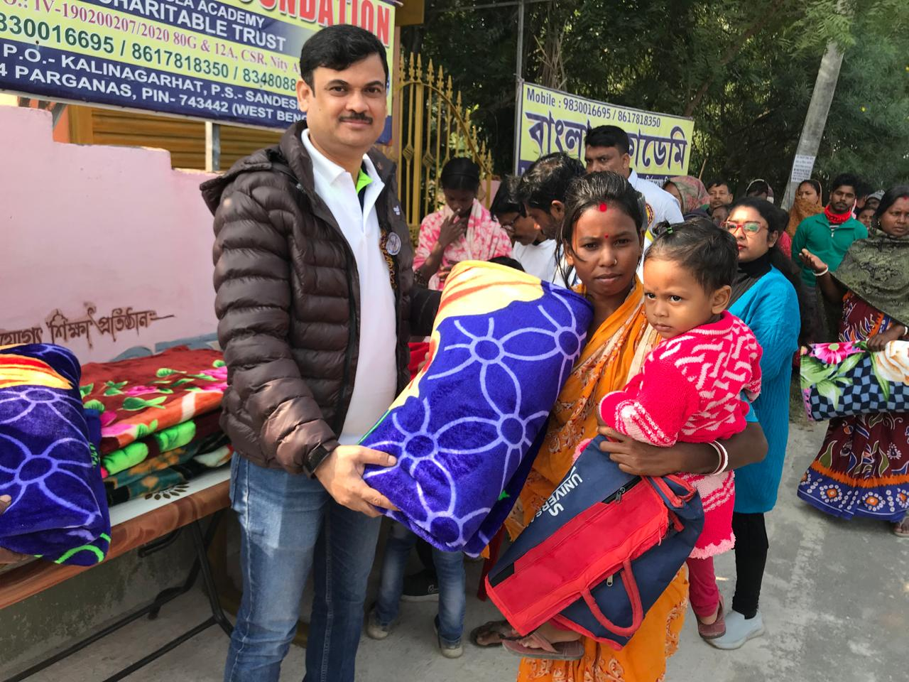
Disaster Relief Initiatives
Sponsor: Erbe Medical India Pvt Ltd
Bankura, Sandeshkhali

Slide 19
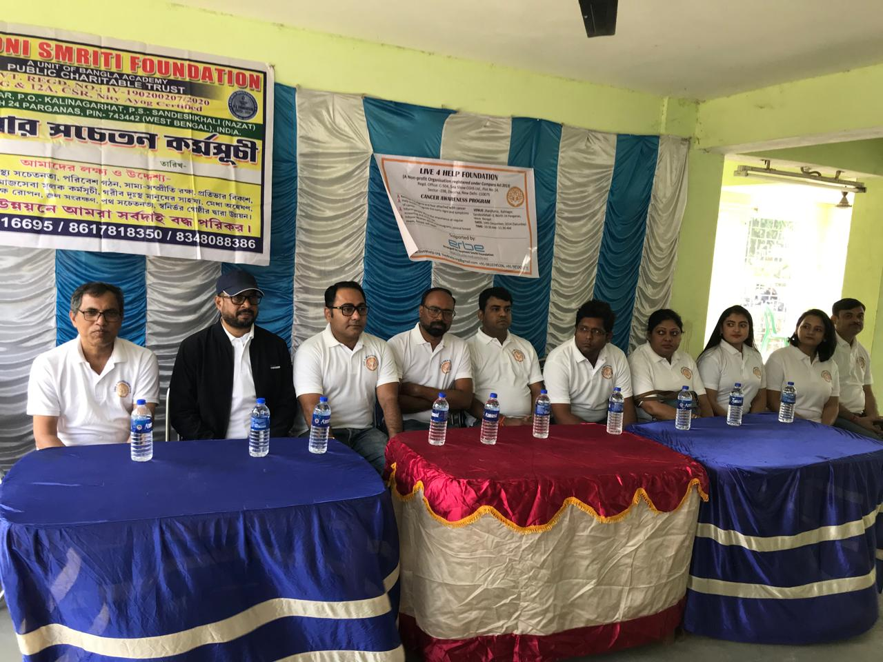
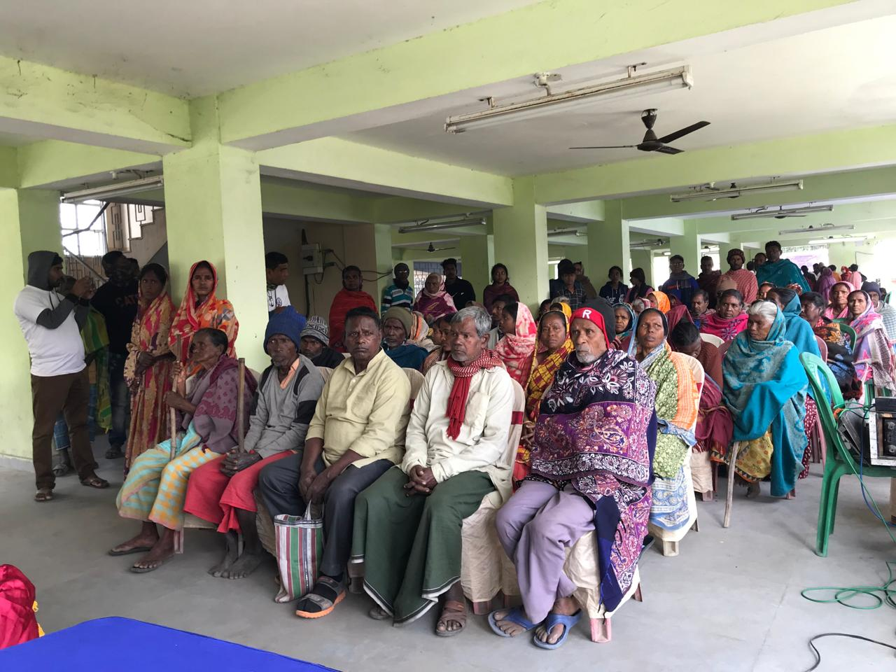
Medical Camp at Sandeshkhali Sponsor: Erbe Medical India Pvt Ltd
Let us hear from
Mr. Rakesh Kundu, Managing Director
Erbe Medical India Pvt Ltd Team Erbe
Mr Rakesh Kundu, Mr. Rwiddhi Sarkar
Ms. Monalisa Das, Mr. Prasun Dutta
Mr. Shuvayu Ghosh, Mr. Subir Kar
Mr. Bibhu Dey, Ms. Sriya Lenka

Slide 20
Financials Tarun Maiti

Slide 21
Audited Financial Year Statement
FUNDS RECEIVED | As on 31st March 2024 | As on 31st March 2023
Education | ₹ 6,95,311 | ₹ 3,51,910
Health | ₹ 3,07,000 | ₹ 2,32,856
Plantation | ₹ 6,83,000 | ₹ 12,000
Relief Work | ₹ 1,45,342 | -
Membership Fees | ₹ 64,000 | ₹ 27,000
Other Donation | ₹ 10,000 | ₹ 1,72,381
TOTAL | ₹ 19,04,563 | ₹ 7,96,147
FUNDS UTILIZED | As on 31st March 2024 | As on 31st March 2023
Education | ₹ 5,26,876 | ₹ 4,60,555
Health | ₹ 3,13,085 | ₹ 2,26,271
Plantation | ₹ 66,000 | ₹ 16,500
Relief Work | ₹ 1,45,342 | -
Professional Expenses | ₹ 34,220 | ₹ 14,160
Other Expenses | ₹ 3,05,000 | -
TOTAL | ₹ 13,90,523 | ₹ 8,20,728
Received 80G and 12A certificates
80G > Donor’s tax exemption
12A > Our tax exemption

Slide 22
Current Financial YTD (April’24-till date) Statement
FUNDS RECEIVED | 1st April 2024 till date | AUDITED: As on 31st March 2024 | AUDITED: As on 31st March 2023
Education | ₹ 6,55,685 | ₹ 6,95,311 | ₹ 3,51,910
Health | ₹ 2,35,000 | ₹ 3,07,000 | ₹ 2,32,856
Plantation | ₹ 6,00,000 | ₹ 6,83,000 | ₹ 12,000
Relief Work | ₹ 4,36,834 | ₹ 1,45,342 | -
Membership Fees | ₹ 34,000 | ₹ 64,000 | ₹ 27,000
Other Donation | ₹ 18,800 | ₹ 10,000 | ₹ 1,72,381
TOTAL | ₹ 19,80,319 | ₹ 19,04,563 | ₹ 7,96,147
Thanks for your generous support with increased donation and sponsorship

Slide 23
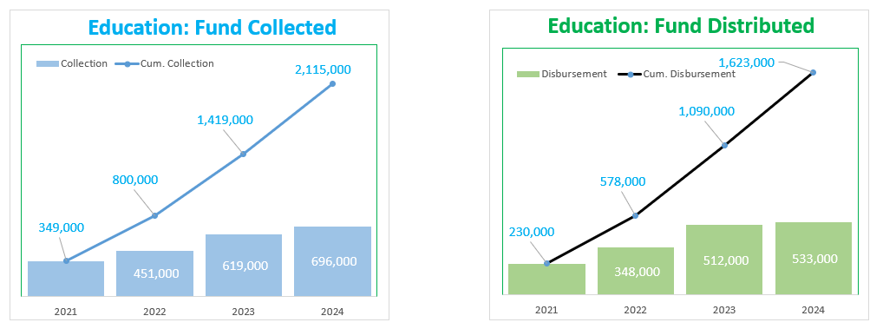
We aspire to have faster growth in fund collection.
We solicit your generous support

Slide 24
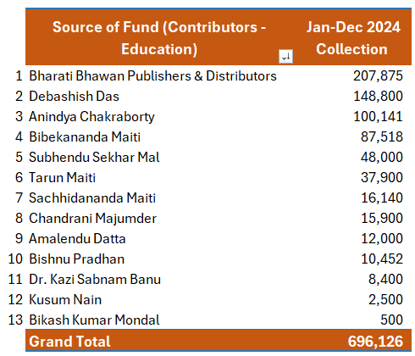
We would like to express
our sincere gratitude and
a big thank for your continued support

Slide 25
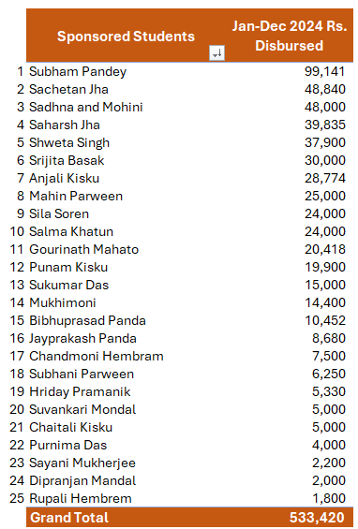
A little assistance of yours can immensely help someone to pursue their dream..

Slide 26
We solicit your support Debasish Das Ramkrishna Sadhukhan Shubhendu Sekhar Mal

Slide 27
L4H Solicits Your Support
Education
Sponsoring annual school fees. We send flyers of candidates
Donating laptop/desktop computers
Online coaching a student
Sponsoring partial fees of a student
Relief work
Material donation & participation
Plantation
Sponsoring and participation
Medical camps
Sponsoring & participation
New Membership & Annual Fee
Rs. 5,000
Life Membership Fee (one time)
Rs. 25,000
Donation of Indian citizen is eligible for tax rebate U/S 80G of Income Tax Act

Slide 28
q&a sessions
How do you contribute : inland donors and overseas donors
When do you contribute
Getting the tax rebate certificate
Participation process in different activities time-to-time.
Coaching a student
Counselling a student
Speaking about the impact
Any other questions

Slide 29
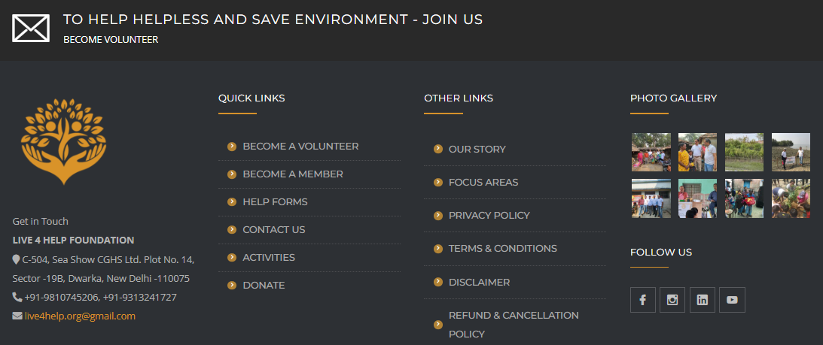
https://live4help.org/

Slide 30
We all say ‘thank you’.

